Slide 1
Introduction to Quantum Computing
By Amrutha TESR - 22071A6776
Notes:
and today I’ll be introducing you to one of the most exciting developments in the field of technology—Quantum Computing.

Slide 2
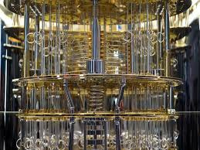
What is Quantum Computing?
Quantum computing is a new paradigm of computing that leverages the principles of quantum mechanics to perform computations that are infeasible for classical computers.
Classical computers use bits (0 or 1) as the smallest units of data.
Quantum computers use qubits, which can represent both 0 and 1 simultaneously, enabling much greater parallelism.
Quantum computers could revolutionize fields like cryptography, materials science, and machine learning by solving complex problems that classical computers can’t handle efficiently.
Notes:
“Quantum computing is a new kind of computing that’s different from the classical computers we use today. While classical computers use bits, which can be either 0 or 1, quantum computers use qubits. Qubits can be both 0 and 1 at the same time, allowing them to process more information much faster.”

Slide 3
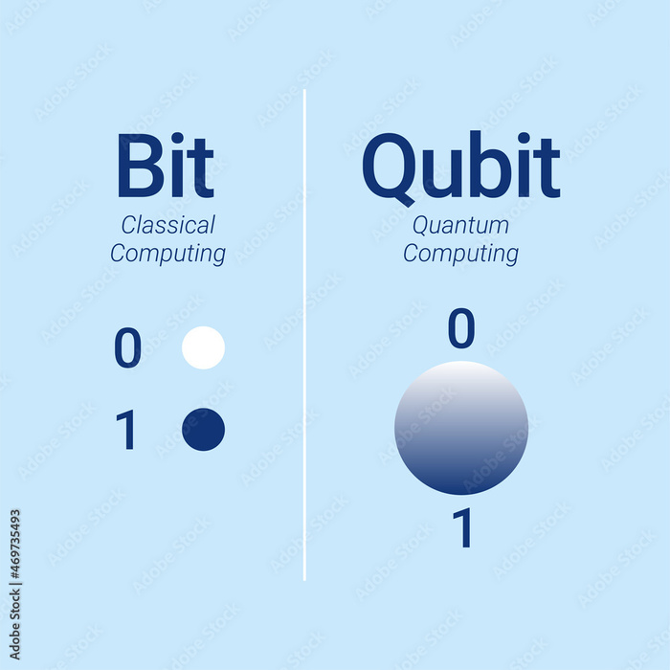
Classical Bits vs Qubits
Classical Bits:
In classical computing, information is processed in bits, which are either 0 or 1. Each operation manipulates these bits in fixed states.
Qubits:
Qubits are quantum bits, and unlike classical bits, they can exist in a state of 0, 1, or both at the same time due to superposition.
Entanglement: When qubits become entangled, the state of one qubit is directly related to the state of another, no matter the distance between them.
This enables a quantum computer to process multiple possibilities simultaneously.
Notes:
“In classical computing, bits are either on or off, 0 or 1. But qubits are different. They can be in multiple states at once. This ability to be in both 0 and 1 at the same time makes quantum computers much more powerful when handling certain types of problems.”

Slide 4
Key Principles of Quantum Mechanics
Superposition: A qubit can represent multiple possible combinations of 0 and 1. This allows quantum computers to perform many calculations simultaneously.
Example: If you have two qubits, they can represent four states (00, 01, 10, 11) at the same time.
Entanglement: When qubits are entangled, the state of one directly influences the other, regardless of distance. This can significantly speed up computations.
Example: Imagine two entangled qubits: if you measure one, you instantly know the state of the other.
Quantum Interference: Quantum computers can amplify the probability of correct answers and cancel out wrong answers by using interference patterns between qubits.
Notes:
“Quantum computers work because of three main principles:
Superposition: Qubits can be in multiple states at once.
Entanglement: Qubits can be connected in such a way that the state of one qubit affects another, even if they are far apart.
Interference: Quantum interference helps us focus on the correct answers by boosting the right results.”

Slide 5
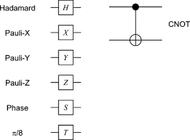
How Do Quantum Computers Work?
Quantum Gates: Quantum gates are operations applied to qubits. Unlike classical logic gates, quantum gates can manipulate qubits in ways that take advantage of superposition and entanglement.
Example gates: Hadamard gate, Pauli-X gate, and CNOT gate.
Quantum Circuits: Multiple quantum gates applied to qubits form quantum circuits. These circuits perform computations by manipulating the state of the qubits.
Measurement: Once the computation is complete, the qubits are measured, collapsing them into a classical bit (either 0 or 1).
Notes:
“Quantum computers use quantum gates, similar to how classical computers use logic gates. These gates control and change the states of qubits. When you measure the qubits at the end, they collapse into a 0 or 1, giving you a final result.”

Slide 6
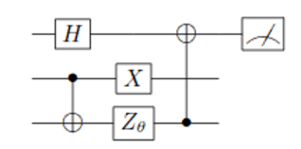
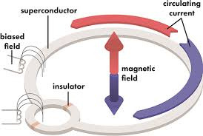
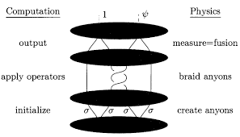
Quantum Computing Models
Quantum Circuit Model: The most common model, based on applying quantum gates to qubits. Similar to classical circuits but operates on qubits.
Adiabatic Quantum Computing (AQC): This approach solves problems by gradually evolving the system from an initial state to a ground state that encodes the solution.
Topological Quantum Computing: This model uses "braiding" of quasiparticles to create fault-tolerant quantum gates. It is theoretically more resistant to errors.
Notes:
“There are different models of quantum computing. The most common one is the Quantum Circuit Model, where qubits are manipulated through quantum gates. There’s also Adiabatic Quantum Computing, which finds solutions by slowly evolving the system, and Topological Quantum Computing, which is focused on reducing errors.”

Slide 7
Quantum Algorithms
Shor’s Algorithm: Revolutionized cryptography by making it possible to factor large numbers exponentially faster than classical algorithms. If fully realized, quantum computers could break today’s encryption methods (RSA).
Grover’s Algorithm: Offers a quadratic speedup for searching unsorted databases. It’s especially useful in optimization and search problems.
Other Algorithms: Quantum Fourier Transform,
Quantum Machine Learning algorithms, etc.
Notes:
"Quantum computing has some exciting algorithms.
Shor’s Algorithm can break encryption by quickly factoring large numbers.
Grover’s Algorithm speeds up searching through large databases.
These are just a couple of ways quantum computers can outperform classical computers.”

Slide 8
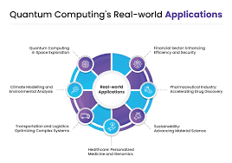
Potential Applications
Cryptography: Quantum computers could break RSA encryption but also create new encryption methods (Quantum Key Distribution).
Drug Discovery: Quantum computers can simulate molecular interactions, helping design new drugs and materials faster than classical computers.
Optimization Problems: Complex problems in logistics, finance, and supply chains could be solved more efficiently using quantum optimization algorithms.
Machine Learning: Quantum algorithms could improve data classification, optimization, and neural networks for faster and more accurate AI models.
Notes:
“Quantum computing has many potential uses. It could improve encryption, help find new drugs, solve optimization problems like delivery routes, and even make artificial intelligence smarter and faster.”

Slide 9
Current State of Quantum Computing
IBM: IBM’s Quantum Experience provides cloud access to quantum computers for researchers and developers.
Google: Google’s Sycamore quantum processor achieved quantum supremacy by solving a complex problem exponentially faster than classical computers.
Microsoft, Rigetti: Other players like Microsoft and Rigetti are also making strides in quantum hardware and software.
Current Quantum Computers:
Qubits Count: Quantum computers currently have limited qubits (around 50-100).
Performance: Decoherence and error rates are still major challenges to achieving practical quantum advantage.
Notes:
“Today, companies like IBM, Google, and Microsoft are working hard to build better quantum computers. Google’s Sycamore processor made headlines when it solved a problem in seconds that would take classical computers thousands of years. But quantum computers today still have limits—they’re small and error-prone.”

Slide 10
Challenges and Limitations
Quantum Decoherence: Qubits are highly sensitive to their environment, which causes them to lose their quantum state quickly, leading to errors.
Error Correction: Quantum computers need sophisticated error correction codes, which require many additional qubits to maintain accuracy.
Scalability Issues: Building large-scale quantum computers is difficult due to qubit instability and complex cooling requirements.
Environmental Requirements: Quantum computers need to operate at extremely low temperatures (near absolute zero) to maintain their quantum states.
Notes:
“Quantum computing has challenges. Decoherence happens when qubits lose their state due to environmental factors. Error correction is difficult and needs a lot of extra qubits to fix mistakes. Lastly, building larger and more stable quantum computers is still very hard.”

Slide 11
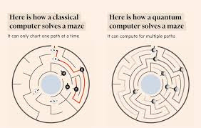
Quantum Computing vs Classical Computing
Quantum Computing Strengths:
Can solve certain complex problems (e.g., factoring large numbers) exponentially faster than classical computers.
More efficient in optimization and simulation tasks.
Classical Computing Strengths:
Still better suited for most everyday tasks (e.g., word processing, web browsing, database management).
More reliable and cost-effective for a wide range of general-purpose computing.
Notes:
“Quantum computers won’t replace classical computers—they’ll work alongside them. Classical computers are great for everyday tasks, but quantum computers will help solve specialized, complex problems like optimizing large systems or cracking tough codes.”

Slide 12
Future of Quantum Computing
Quantum Advantage: The stage after quantum supremacy, where quantum computers can solve real-world, commercially relevant problems faster than classical computers.
Expected Timeline: Experts predict that practical, large-scale quantum computers could be developed within 10 to 20 years.
Industries: Finance, healthcare, cybersecurity, AI, and logistics are expected to be transformed by quantum computing in the future.
Notes:
“Looking forward, quantum computers are expected to get better and more powerful. Within the next 10 years, we could see quantum advantage, where quantum computers are used for practical, real-world tasks. This could change industries like healthcare, finance, and artificial intelligence.”

Slide 13
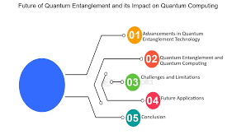
Ethical Implications
Data Privacy: Quantum computers could break current encryption, leading to concerns about data security and privacy.
Quantum Encryption: On the flip side, quantum cryptography (e.g., Quantum Key Distribution) offers more secure communication methods.
Access to Quantum Power: There’s a potential for inequality if only large corporations or governments have access to quantum computing power, creating ethical dilemmas.
Notes:
“With great power comes great responsibility. Quantum computers could break our current encryption methods, threatening privacy. But they could also create stronger security systems. We must also think about who has access to this technology—if it’s limited to just a few companies or governments, it could create inequalities.”

Slide 14
Thank You

